Slide 1
Department of Tourism & Hospitality
Dr Noel Murray
7th December 2017

Slide 2
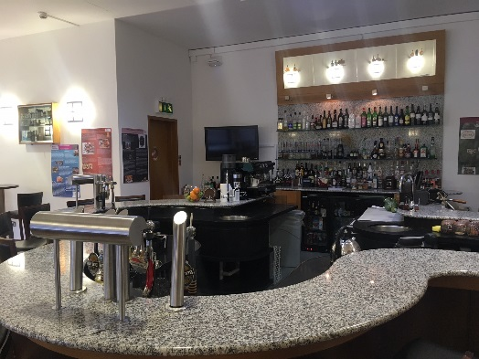
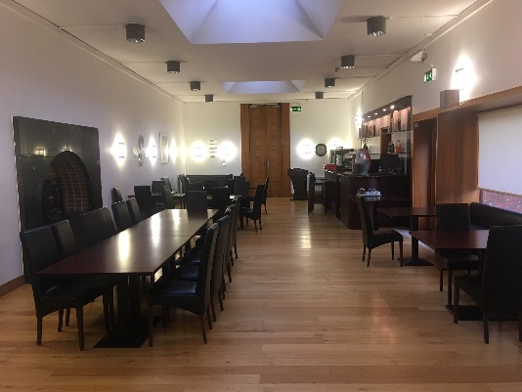
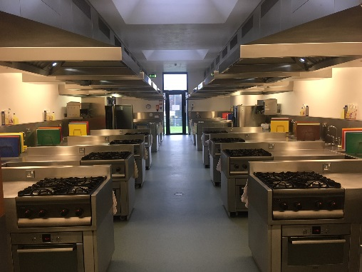
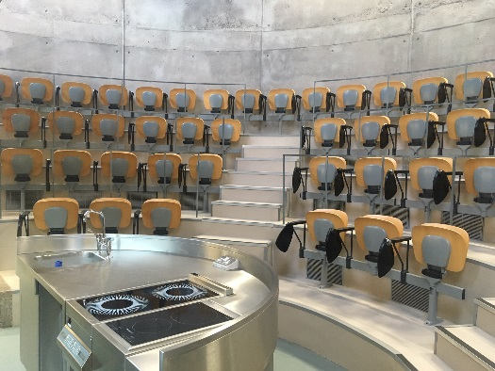
Department Overview
650 students (approx.) studying for: | State of the art Facilities:
Culinary/Food Industry Hospitality Industry Tourism Industry Beverage/Drinks Industry | 7 Professional Kitchens Demonstration Kitchen Training Restaurant Training Bar Computer Labs

Slide 3
Department of Tourism & Hospitality
Course Overview - CAO
CAO | Title | Level | Duration
CR660 | BBUS (H) in Tourism Management | 8 | 4 Years FT
CR041 | BBUS in Tourism Management | 7 | 3 Years FT
CR042 | BBUS in Hospitality Management | 7 | 3 Years FT
CR640 | BBUS in Culinary Arts | 7 | 3 Years FT
CR650 | BBUS in Beverage Industry Management | 7 | 3 Years FT
CR655 | Higher Certificate in Culinary Studies | 6 | 2 Years FT
CR657 | Higher Certificate in Hospitality Studies | 6 | 2 Years FT

Slide 4
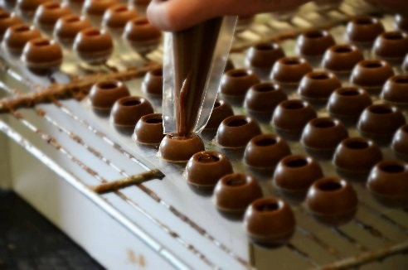
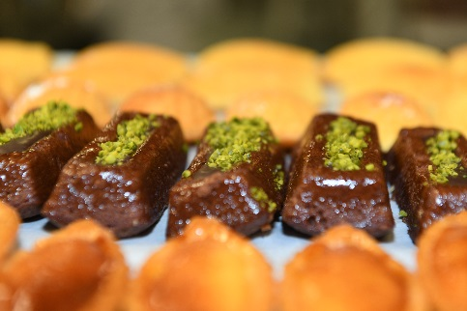
Notable Changes:
Course Title:
BBUS in Tourism Management (Level 7 & Level 8)
BBUS in Beverage Industry Management (Level 7)
Course Development:
BBUS in Culinary Entrepreneurship (Level 8)
1 Year Add-On to BBUS in Culinary Arts

Slide 5
1 Year Add-On…
Bachelor of Business (Hons) in Culinary Entrepreneurship

Slide 6
Department of Tourism & Hospitality
Progression Routes

Slide 7
Thank you
Dr Noel Murray
Contact Details
E: noel.murray@cit.ie
T: 021 - 4335822

